Slide 1
Application of Project Management Tools to Car Manufacturing Project
Name
Institutions of affiliation
Course
Date

Slide 2
Project Description
The project at hand is on manufacturing a car
It will follow the a similar process to that followed by the Toyota company
Also, all the quality control activities will be done in order to ensure that the final product is of the required quality
Notes:
The project is on car production process. It will entail manufacturing of a car using the same strategy employed by the Toyota company. One of the strategies that will be employed in the process is quality control.

Slide 3
Project Description Cont..
The process that will be followed will include the following steps;
    Gathering the law materials
    Design & engineering
    Manufacturing
    Testing and quality assurance
    Launch
Notes:
The project manufacturing process tasks will include gathering the law materials, design & engineering, manufacturing, testing and quality assurance and launch. Also, each of these tasks will include a list of activities.

Slide 4
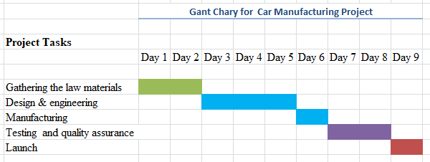
Project Management Charts
Notes:
A Gantt chart is one of the most popular as well as useful ways of showing tasks and event displayed against time (Trojanowska & Dostatni, 2017). Along the top, the chart has a suitable time scale. On the other hand, on the left, the chart contains a list of activities or tasks to be done in project management. Each of the activities in the Gantt chart is represented by a bar (Trojanowska & Dostatni, 2017). It is important to note that the length of the bar reflects the start date, the duration as well as the end of the activity.

Slide 5
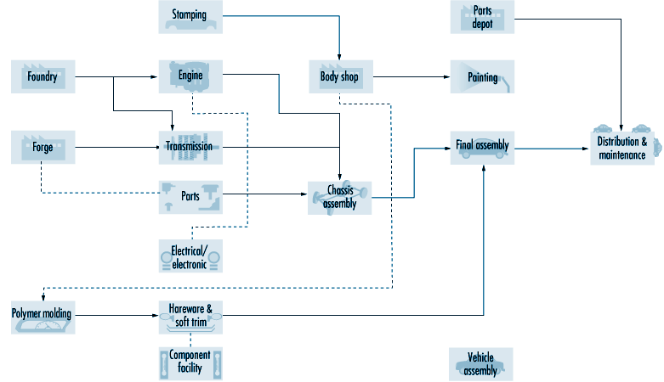
Improved Process Flow Chart from Week 1

Slide 6
Meeting cadence/rhythm and timing
A meeting cadence refers to a pattern of regular team meetings
It should be noted that short, frequent meetings increases a team's work momentum.
Also, groups that offer oversight, such as boards as well as committees, hold lengthier meetings less.
frequently
Notes:
The meetings will be engaging. The meetings will encourage involvement from the attendees. Also, the leader will encourage the audience to capture their imagination as well as keep attention to areas where most needs to be accomplished. Also, during the meetings, the attendees will be required to take notes for future reference. The notes that will be collected will include notes about what went right, what went right and the feedback from different project stakeholders.

Slide 7
Meeting cadence/rhythm and timing Cont..
These features will characterize the meetings;
They will be well organized
An agenda will always be provided
Having an agenda that is printed out for your meeting is helpful in two ways.
Having an agenda is important for the meetings because it will help the leaders to keep the discussion on the topic of discussion.
Notes:
It is important to note that meeting rhythm or meeting cadence plays an important role in the effective implementation or execution of project. Also, the project cadence is important since it sets the foundation for communicating the projects strategic priorities. Also, it ensures that every individual is aligned and updated on the progress of the project and the completion of different project deliverables. Besides, it helps in creating a culture of accountability, transparency, and feedback.

Slide 8
Metrics to measure the project’s success
Customer Satisfaction Score
A customer satisfaction score is important since it will help in providing a measure of quality for the car manufactured.
This metric will be guided by customer survey data.
The score will be determined by whether the car is able to do what it was meant to do as well as satisfy real customer needs.
Notes:
Since the customer provided the requirements for the design and manufacturing of the car, she is in a better position to determine whether the design and manufacturing of the car was successful. This will be determined by the customer satisfaction score. The score the customers will grant the car will help the company in determining whether it executed the design needs of the customer with perfection.

Slide 9
Metrics to measure the project’s success Cont..
Return on Investment (ROI)
RoI will look at the dollar amount that is earned for the amount of money that is invested into the car production project.
Rather than looking at the overall profit, the RoI will look at the specific benefit earned from the project divided by the cost used for the production of the car.
The formula that will be used for finding the RoI is as follows;
ROI = (Net Benefits/Costs) x 100
Notes:
There are several benefits of ROI. One of the benefits of ROI is that it is a better measure of profitability. ROI relates net income from the product to investments (Walasek & Barszcz, 2017). This kind of cost benefit analysis is important since it helps managers in finding out the rate of return that can be expected from diverse investment proposals. Also, it is exceptionally useful for measuring success over a long time (Walasek & Barszcz, 2017).

Slide 10
Metrics to measure the project’s success Cont..
Productivity Time: The project will be described as success if the time used for the production of the car is as was initially decided. The time should be as little as possible
Gross Profit Margin: The car production project will be said to be successful if the gross profit from the sale of the car is high
Notes:
Gross profit margin refers to a metric used by analysts for purposes of assessing an organization’s financial health. It is used for calculating the amount of money that is left from the sales of a product after subtracting the cost of production (Nariswari & Nugraha, 2020). The cost gross profit margin for this project will be calculated by taking the total revenue minus the cost of production and dividing the difference by the overall revenue. The gross margin outcome will be multiplied by 100 in order to present the figure in the form of a percentage.

Slide 11
Financial and budgetary considerations
The budget of the car production project will be determined by calculating all the inputs that will go into ensuring the successful production of the car
The budget for the car production will be determined by the cost of the raw materials, the total cost of the labor that will go into the car manufacturing process, and the cost of other factors that will make the car production a success.
Notes:
Several steps will be followed in order to do budgeting for the project. These steps include breaking down the project into milestones and tasks, estimating the cost of each of the items in the task list, summation of the budget estimates for all the tasks and milestones, adding contingency and taxes to the already calculated budget and getting approval from the management.

Slide 12
Description of the project reporting structure
The progress of the project will be recorded after every activity or task of the project
Also, the progress of the completion of every project deliverable will be recorded both during and after the completion of every deliverable
After the completion of the project, the records of all the project deliverables will be combined to come up with the final report of the project
Notes:
The final report of the project will comprise of various sections such as an abstract, the background of the project, milestones achieved, budget of the project, risks faced during the project completion, actions and decisions, the contact details of various individuals involved in the development of the project and the final summary of the whole project.

Slide 13
References
Fernando, Y., Walters, T., Ismail, M. N., Seo, Y. W., & Kaimasu, M. (2018). Managing project success using project risk and green supply chain management: A survey of automotive industry. International Journal of Managing Projects in Business.
Heigermoser, D., de Soto, B. G., Abbott, E. L. S., & Chua, D. K. H. (2019). BIM-based Last Planner System tool for improving construction project management. Automation in Construction, 104, 246-254.
Kerzner, H. (2019). Using the project management maturity model: strategic planning for project management. John Wiley & Sons.
Petrillo, A., De Felice, F., & Zomparelli, F. (2019). Performance measurement for world-class manufacturing: a model for the Italian automotive industry. Total Quality Management & Business Excellence, 30(7-8), 908-935.

